Slide 1
Crime Hot-Spot Prediction using Indicators Extracted from Social Media
Matthew S. Gerber, Ph.D.
Assistant Professor
Department of Systems and Information Engineering
University of Virginia

Slide 2
IACA Presentations on Social Media
The Modern Analyst and Social Media (Woodward)
Impacts of Social Media on Flash Mobs and Police Response (Ramachandran)
Social Media Tools for Situational Awareness (Mills)
Fighting Underage Drinking through Hotspot Targeting and Social Media Monitoring (Fritz)
Social Media for Crime Analytics in Undercover Investigations 2.0 (Machado)
Advancing Intelligence-Led Policing through Social Media Monitoring (Roush)

Slide 3
Contributions
Analysis
What might Twitter add to environmental risk terrains?
Automation
No manual analysis of tweets
No preconceived notions of what is salient for crime
Scale
800,000 tweets/month; 25,000/day
1 prediction takes 1 hour on 1 CPU core (scales linearly)
Predictive performance
Comparisons with KDE and RTM

Slide 4
Intended Audience
Machine learning & data mining
Logistic regression, random forests, etc.
Risk Terrain Modeling
Density modeling
Social media analytics
Geographic information systems

Slide 5
Outline
Static Environments and Dynamic Activities
Basic Concepts
Related Work
The Twitter API
Hot-Spot Prediction via Twitter
Performance Assessment
The Rest…

Slide 6
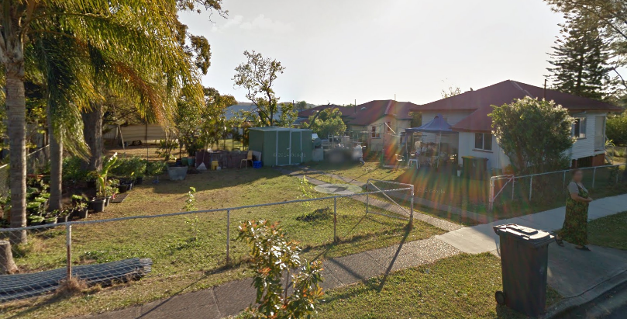
Static Environments

Slide 7
Static Environments
Built environments
Bars, houses, streets, gas stations, etc.
Demographics
Change over time, but slowly
Updated measurements are infrequent
Many tools excel at static analyses

Slide 8
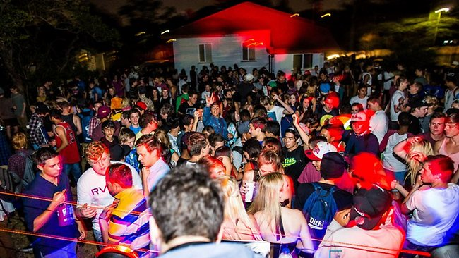
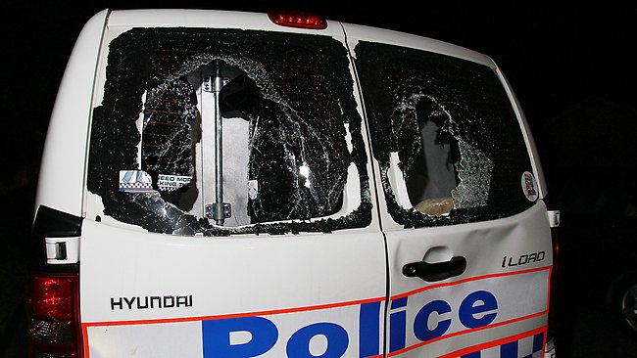
Dynamic Activities
“Facebook-organized party turns into riot”

Slide 9


Dynamic Activities
Same place, different activities
Should alter the risk terrain of a physical space
Pritzker Park, Chicago

Slide 10
Outline
Static Environments and Dynamic Activities
Basic Concepts
Related Work
The Twitter API
Hot-Spot Prediction via Twitter
Performance Assessment
The Rest…

Slide 11

Predicting Crime using Twitter
Working late ☹
Watching the waves
Beer me

Slide 12
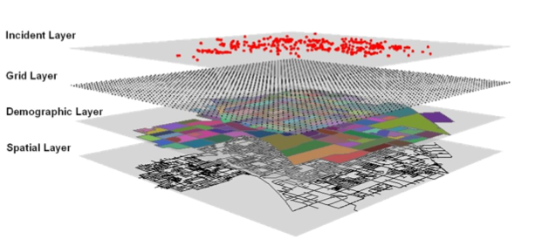
Goal: Automatically Discover/Monitor Leading Indicators
Watching the waves
Beer me
Working late ☹
Twitter Layer

Slide 13
Outline
Static Environments and Dynamic Activities
Basic Concepts
Related Work
The Twitter API
Hot-Spot Prediction via Twitter
Performance Assessment
The Rest…

Slide 14
Related Work
Crime analysis
RTM (Caplan and Kennedy, 2011)
Feature-based prediction (Xue and Brown, 2006)
Hot-spot maps (Chainey et al., 2008)
Prediction via social media (Kalampokis et al., 2013)
Disease outbreaks
Election results
Box office performance
…

Slide 15
Outline
Static Environments and Dynamic Activities
Basic Concepts
Related Work
The Twitter API
Hot-Spot Prediction via Twitter
Performance Assessment
The Rest…

Slide 16
Tweet Objects
Tweet
Text
GPS coordinates (opt-in)
…
User (profile)
Entity (URL)
Place

Slide 17
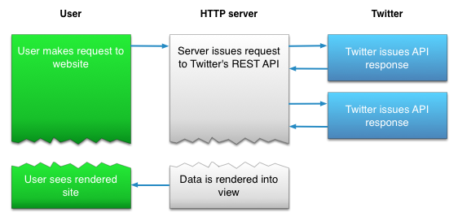
Twitter REST API
REST: Representational State Transfer
Commands
Queries

Slide 18
Twitter REST API
Example commands
Search
String queries (including locations)
450 per 15-minute window
Update status (tweet)
No rate limit
Advantage: Search recent history
Disadvantage: Rate limits

Slide 19
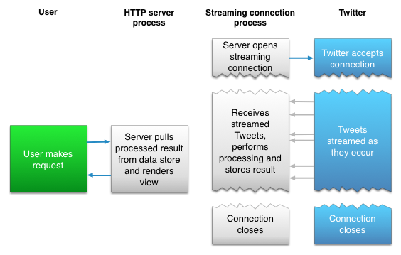
Twitter Streaming API

Slide 20
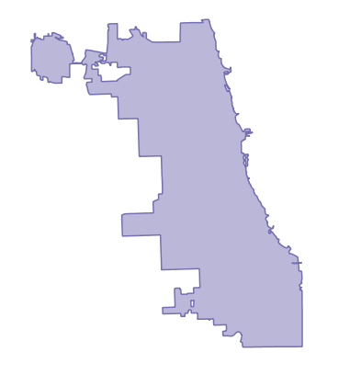

Twitter Streaming API
Example stream: Filter
Lon: -87.5241371038858
Lat: 42.0230385869894
Lon: -87.9401140825184
Lat: 41.6445431225492

Slide 21
Twitter Streaming API
Advantages:
No rate limits
Persistent connection
Disadvantages
No historical search
GPS filter captures 3-5% of all tweets

Slide 22
Storage Requirements
PostgreSQL (MySQL might also work)
PostGIS
All free
Chicago
10 million tweets/year
800,000 tweets/month
25,000 tweets/day
Single desktop workstation

Slide 23
Outline
Static Environments and Dynamic Activities
Basic Concepts
Related Work
The Twitter API
Hot-Spot Prediction via Twitter
Performance Assessment
The Rest…

Slide 24
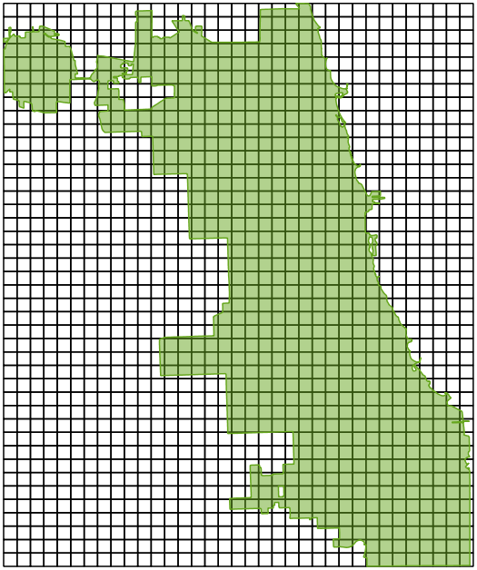
Partitioning GPS-tagged Tweets into “Documents”
Step 1: Get tweets for today
Step 2: Partition into squares
Step 3: Concatenate text
1000m
1000m
“Document”

Slide 25
What are “Documents” about?
Air travel: 0.73
Eating: 0.12
Drinking: 0.10
Shopping: 0.05
1.00
Air travel: 0.07
Eating: 0.43
Drinking: 0.37
Shopping: 0.13
1.00

Slide 26


Topics as Leading Indicators
Party Preparation: 0.87
…
Time
Thursday
Friday
How do we define topics?
How do we assign weights?

Slide 27

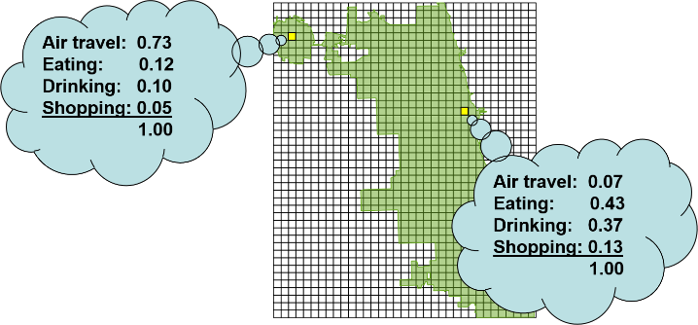
The Magic: Latent Dirichlet Allocation
Inputs
All “documents”
# of topics to detect
LDA
(Blei et al., 2003)
No manual analysis of tweets
No preconceived notions of what topics are present
Many free implementations

Slide 28
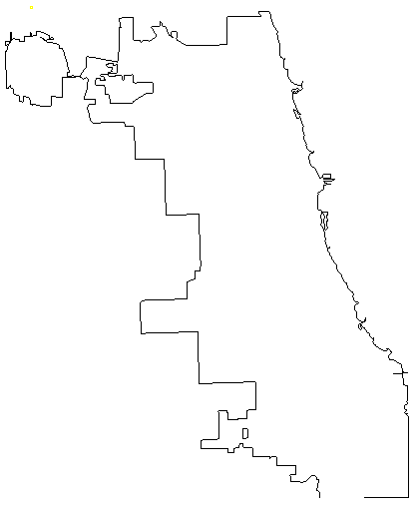
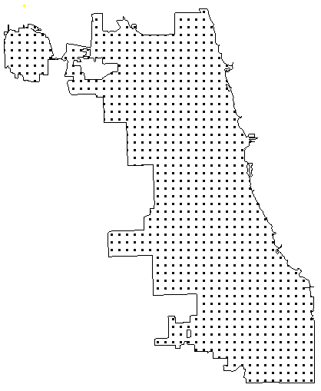
Topics as Leading Indicators (Training)
Establish tweet window (January 1)
Compute topic weights for tweet “documents”
Establish crime window (January 2)
Lay down SHOOTING points
Lay down non-crime points at 200m intervals
Arrange training data
Train binary classifier
Party prep.: 0.83
…
Leading topic weights (independent)
Logistic regression
Support vector machine
Random forest
…

Slide 29
Topics as Leading Indicators (Prediction)
At some point in the future (January 19)
Compute topic weights for tweet “documents”
Lay down prediction points at 200m intervals
Arrange prediction data
Estimate dependent variable (SHOOTING)
Party prep.: 0.83
…
Leading topic weights (independent)

Slide 30
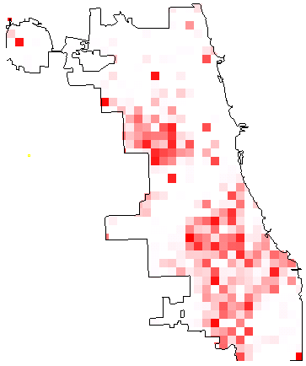
Prediction Output (SHOOTING)

Slide 31
Outline
Static Environments and Dynamic Activities
Basic Concepts
Related Work
The Twitter API
Hot-Spot Prediction via Twitter
Performance Assessment
The Rest…

Slide 32
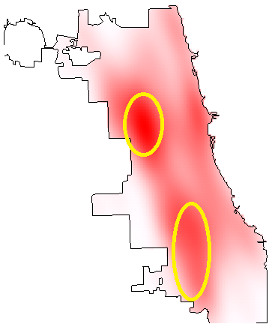
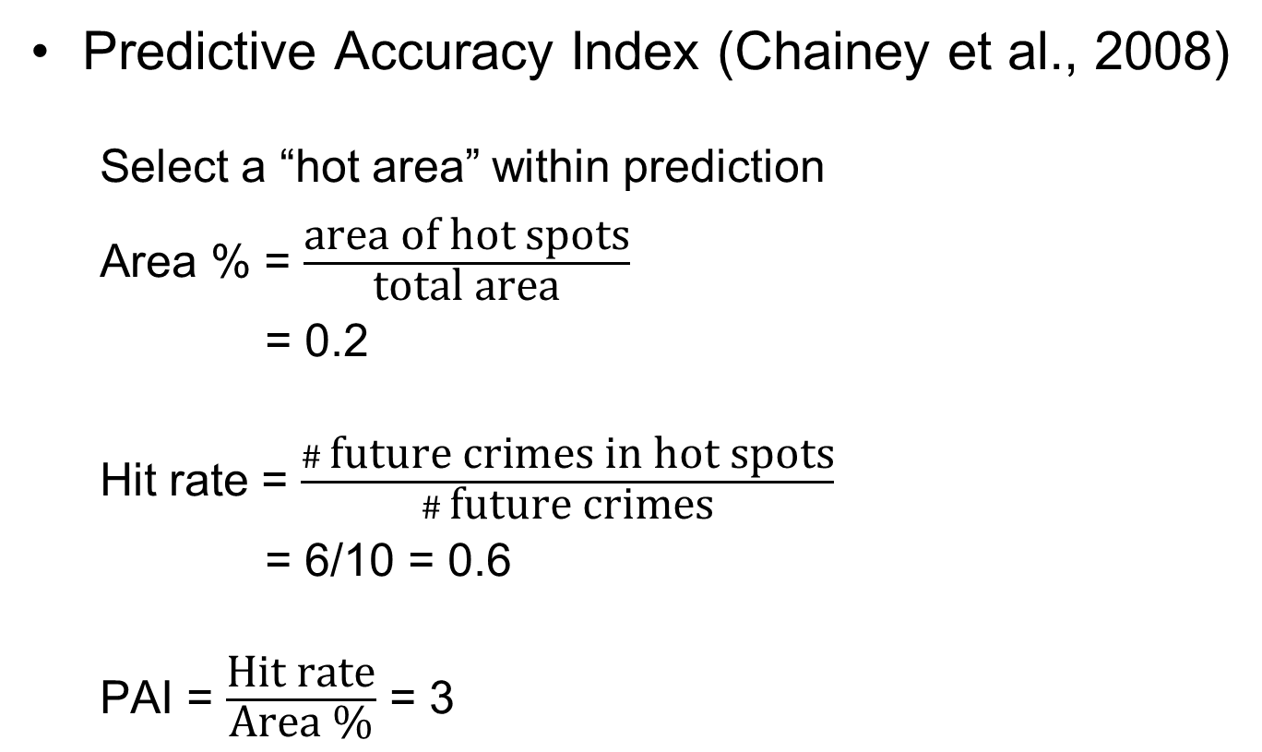
Performance Assessment
Predictive Accuracy Index (Chainey et al., 2008)
Select a “hot area” within prediction
Area % = $\frac{\text{area} \text{of} \text{hot} \text{spots}}{\text{total} \text{area}}$
= 0.2
Hit rate = $\frac{\# \text{future} \text{crimes} \text{in} \text{hot} \text{spots}}{\# \text{future} \text{crimes}}$
= 6/10 = 0.6
PAI = $\frac{\text{Hit} \text{rate}}{\text{Area}\text{ \%}}$ = 3

Slide 33
Performance Assessment
How do we select the “hot area”? Must we?
1
Surveillance Plot
% Area Under the Curve (AUC)
0.6 / 1
Hit rate
(0.1, 0.15): PAI = 0.15 / 0.1 = 1.5
0
1
Hottest X% of the area

Slide 34
Performance Assessment
How do we select the “hot area”? Must we?
1
Surveillance Plot
% Area Under the Curve (AUC)
0.6 / 1
PAI goes up => AUC goes up
Hit rate
0
1
Hottest X% of the area

Slide 35
Performance Assessment
How do we select the “hot area”? Must we?
1
Surveillance Plot
% Area Under the Curve (AUC)
0.6 / 1
PAI goes up => AUC goes up
Hit rate
0
1
Hottest X% of the area

Slide 36
Performance Assessment
How do we select the “hot area”? Must we?
1
Surveillance Plot
% Area Under the Curve (AUC)
0.6 / 1
PAI goes up => AUC goes up
Hit rate
0
1
Hottest X% of the area

Slide 37
Kernel Density Estimation
Threat
Estimation data: historical crime record
Interpretable
Ignores potential features
Environmental backcloth
Social media

Slide 38
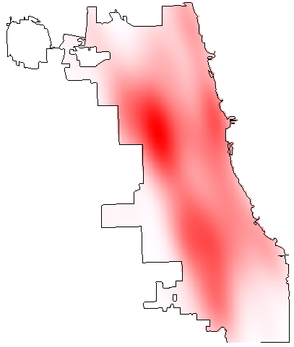
Comparison with Kernel Density Estimate (SHOOTING)
Topics
KDE

Slide 39

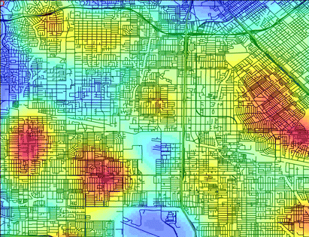

Risk Terrain Modeling
Kid Clusters
Crime Clusters
?
Notes:
Imagine a cluster of crimes in a city. This is a place where certain illegal behaviors occur repeatedly, over time. We might refer to this as a crime hotspot. Now imagine a place where children repeatedly play together. These clusters of kids might be called a hotspot of children playing. If we step back from our focus on the children, we might realize that located where they play repeatedly exists swings, slides and open fields…features of the place (i.e. suggestive of a playground) that attract children there instead of other locations absent such entertaining features.
The concept of an ‘environmental backcloth’ for crime was first proposed by Paul and Patricia Brantingham in 1981. The term refers to “elements that surround an individual and that may influence his or her criminal behavior” (Brantingham and Brantingham, 1981). Both the physical characteristics of places (e.g. buildings, public transportation stops, etc.) and the influence of such characteristics on the surrounding landscape based on individual cognitive assessments and routine activities contribute to the environmental backcloth. (See Naïve Geography article). But, it has never been operationalized for empirical testing.

Slide 40
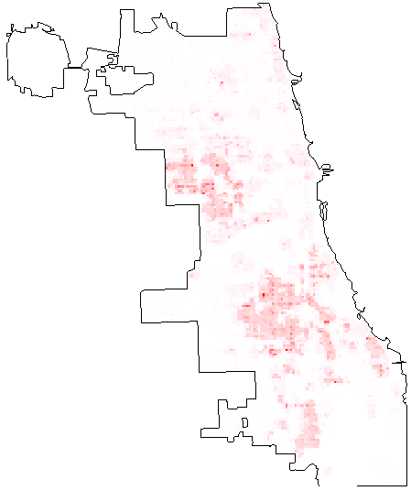
Comparison with Risk Terrain Modeling (SHOOTING)
Topics
RTM

Slide 41
Experimental Setup
Daily predictions
February 2013
Aggregate results
Kernel density estimate (R)
RTM inputs: Derived from 2012 (by Joel Caplan)
Twitter classifier: Random forest (R)
Chicago crime data

Slide 42
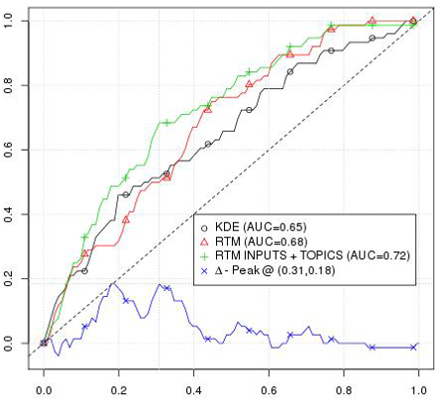
Evaluation Results (SHOOTING)
Hit rate
Hottest X% of the area

Slide 43
Contributions
Analysis
Twitter might add value to environmental risk terrains
Automation
No manual analysis of tweets
No preconceived notions of what is salient for crime
Scale
800,000 tweets/month; 25,000/day
1 prediction takes 1 hour on 1 CPU core (scales linearly)
Predictive performance
Comparisons with KDE and RTM

Slide 44
Future Work
Extended evaluation (not just February 2013)
Richer text model
Semantic analysis
Spatiotemporal projection
Routine activity analysis via Twitter
Tying individual trajectories to crime patterns
Lets drink downtown next weekend!

Slide 45
Outline
Static Environments and Dynamic Activities
Basic Concepts
Related Work
The Twitter API
Hot-Spot Prediction via Twitter
Performance Assessment
The Rest…

Slide 46
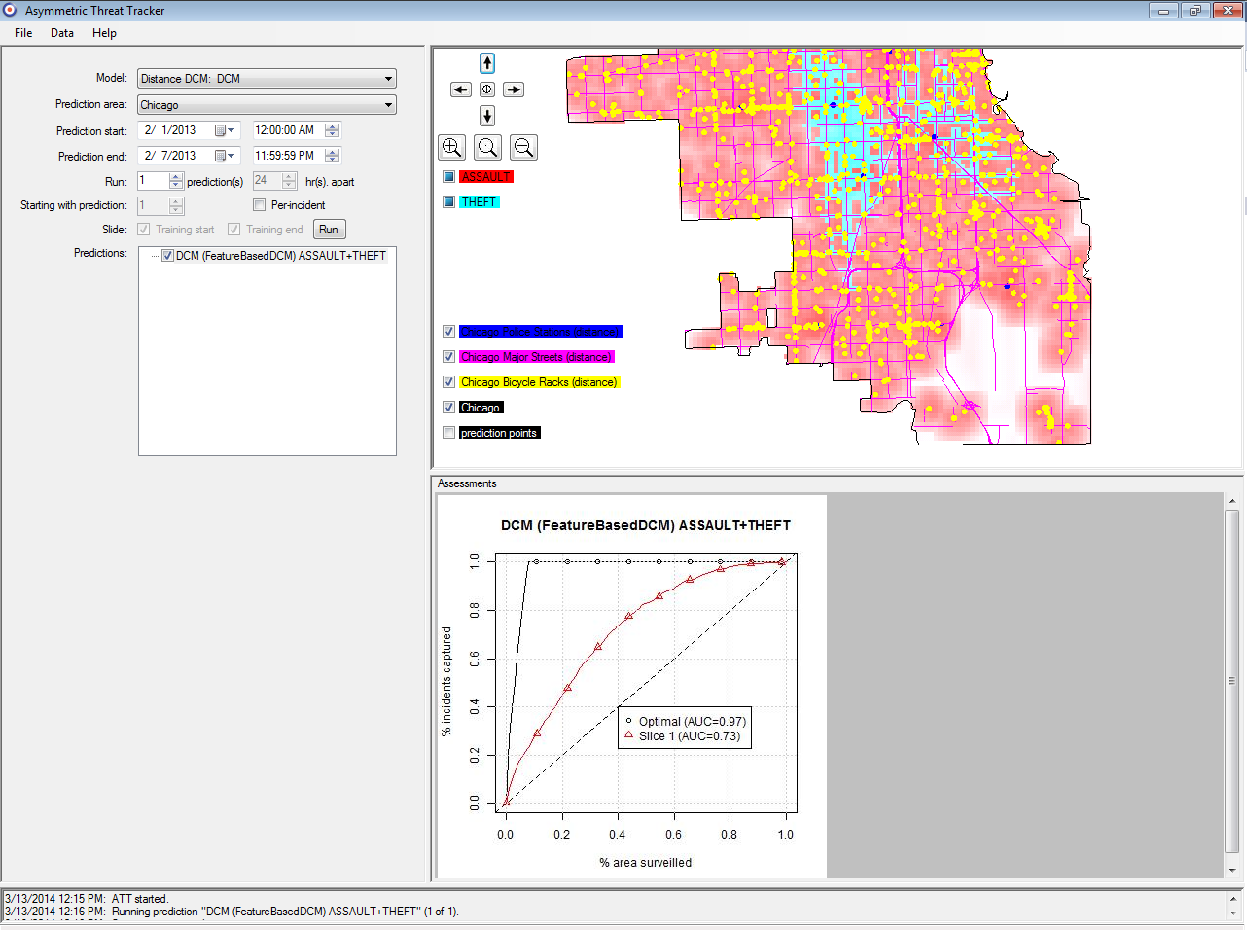
Threat Prediction Software
End-to-end
Ingests RTM
Ingests Tweets
Free (Apache v2)
http://matthewgerber.github.io/asymmetric-threat-tracker

Slide 47
Other Free Software
Twitter data
API documentation
Access API (C#)
Twitter POS tagger
Storage
PostgreSQL / PostGIS
Topic modeling
MALLET
R Topic Models

Slide 48
Contact
My email: msg8u@virginia.edu
Predictive Technology Laboratory
http://ptl.sys.virginia.edu/ptl
predictivetech@virginia.edu
@predictivetech
Take the ConBop survey!

Slide 49
References and Footnotes
Blei, D. M.; Ng, A. Y. & Jordan, M. I. Latent Dirichlet Allocation. J. Mach. Learn. Res., MIT Press, 2003, 3, 993-1022.
Caplan, J. M. & Kennedy, L. W. Risk terrain modeling compendium. Newark, NJ: Rutgers Center on Public Security, 2011.
Chainey, S.; Tompson, L. & Uhlig, S. The Utility of Hotspot Mapping for Predicting Spatial Patterns of Crime. Security Journal, 2008, 21, 4-28.
Gerber, M. Predicting Crime Using Twitter and Kernel Density Estimation Decision Support Systems, 2014, 61, 115-125.
Kalampokis, E.; Tambouris, E. & Tarabanis, K. Understanding the Predictive Power of Social Media. Internet Research, Emerald Group Publishing Limited, 2013, 23.
Xue, Y. & Brown, D. E. Spatial Analysis with Preference Specification of Latent Decision Makers for Criminal Event Prediction. Decision Support Systems, Elsevier, 2006, 41, 560-573.

Slide 50
Backup Slides

Slide 51
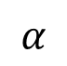

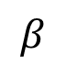



Unsupervised Topic Modeling
Latent Dirichlet allocation (Blei et al. 2003)
A generative story for all text in a neighborhood:
$$β$$
$$φ$$
Pick a word from T1: flight
Generate words for topics
T1: {flight 0.54, plane 0.2, ...}
T2: {shop 0.39, buy 0.12, ...}
$$α$$
$$θ$$
$$T$$
$$W$$
Repeat
Generate topics for neighborhood
{T1 0.92, T2 0.08}
Pick a topic from theta: T1

Slide 52
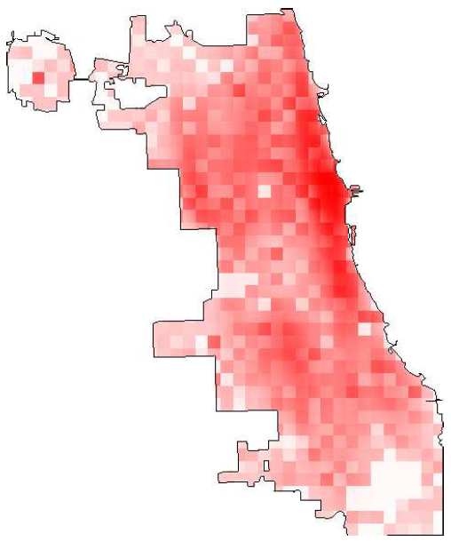
Prediction: Day After Training Window
1000m
1000m
Smoothing

Slide 53
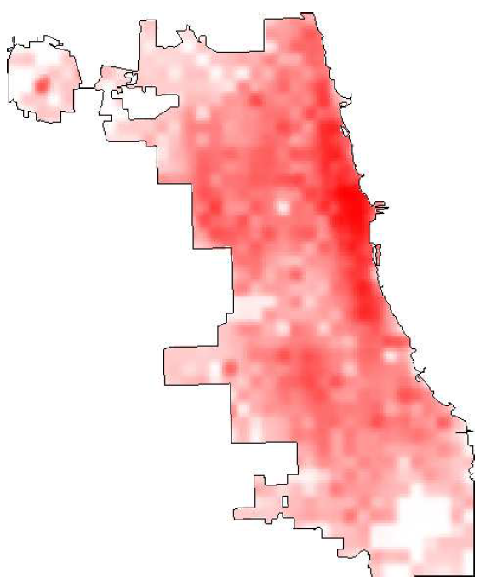
Smoothing Results

